Slide 1
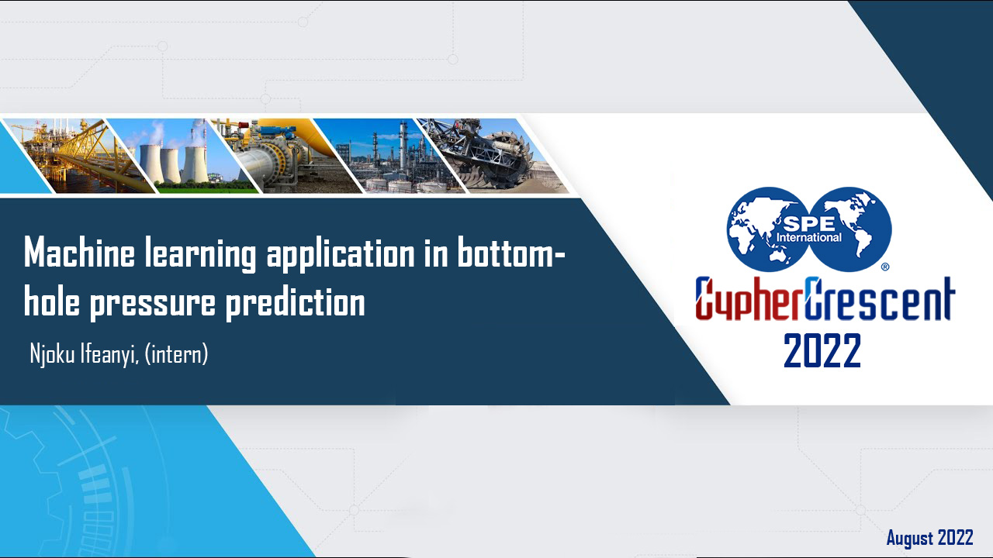

Slide 2


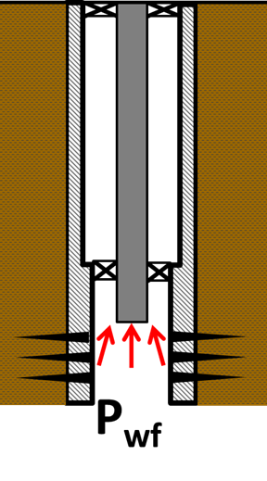
INTRODUCTION
BHP
Flowing bottom-hole pressure (FBHP) is one of the critical parameters in the evaluation of performance of oil and gas wells. The value of FBHP varies during the well's life so, accurate determination and prediction of it are continuously needed for different flow conditions. This project develops machine-learning based models to predict the BHP using three machine learning techniques that are Random forest, Decision Trees, Linear Regression, and artificial neural network (ANN).
`

Slide 3
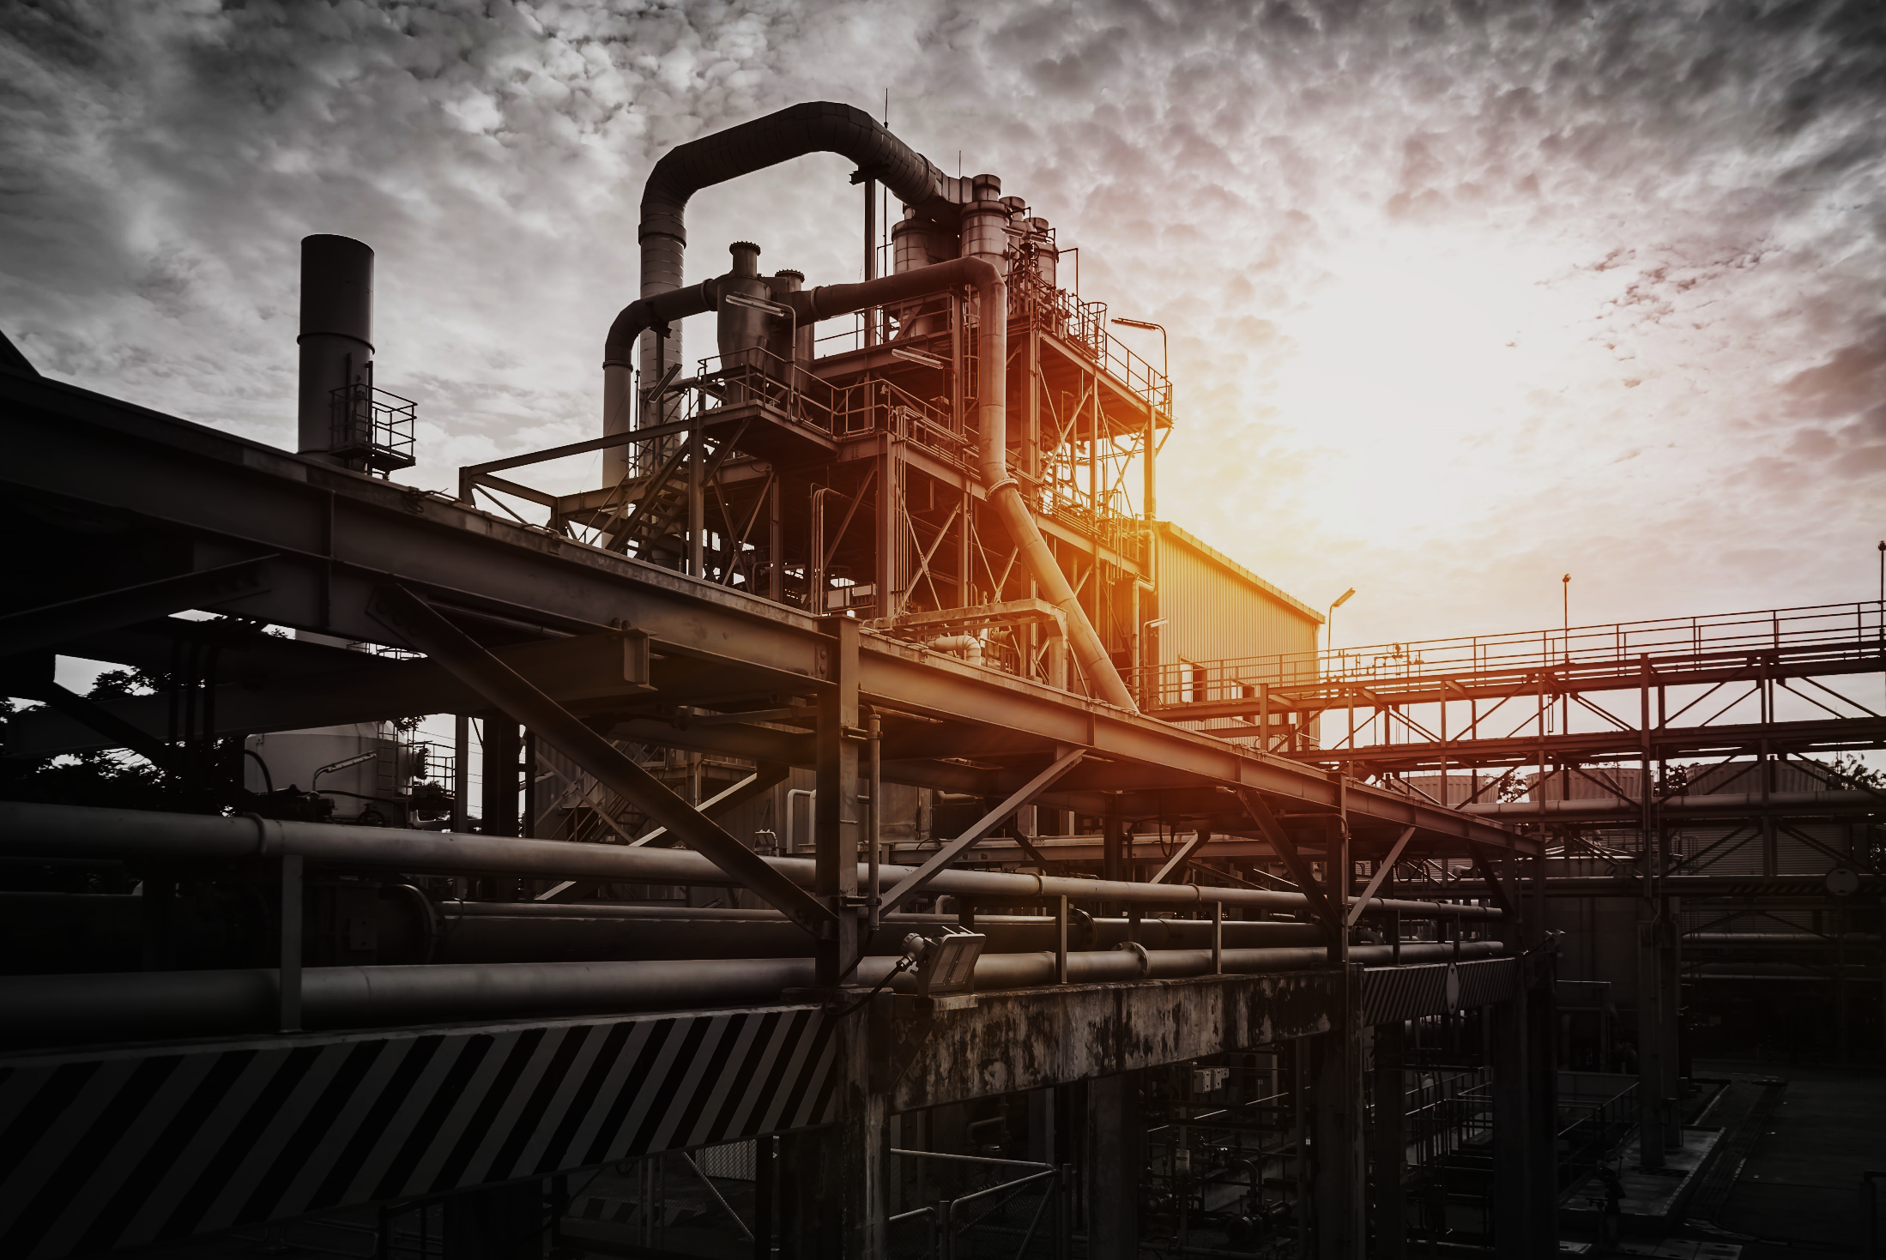

WHY MACHINE LEARNING ?
Machine learning technologies are one discipline of Artificial Intelligence techniques that provides promising tools to help solving human's complex problems.
The ML models were developed based on a surface production data, which means the FBHP is predicted using actual field data.

Slide 4

MACHINE LEARNING
Machine learning (ML) is the subset of artificial intelligence (AI) that focuses on building systems that learn—or improve performance—based on the data they consume.

Slide 5
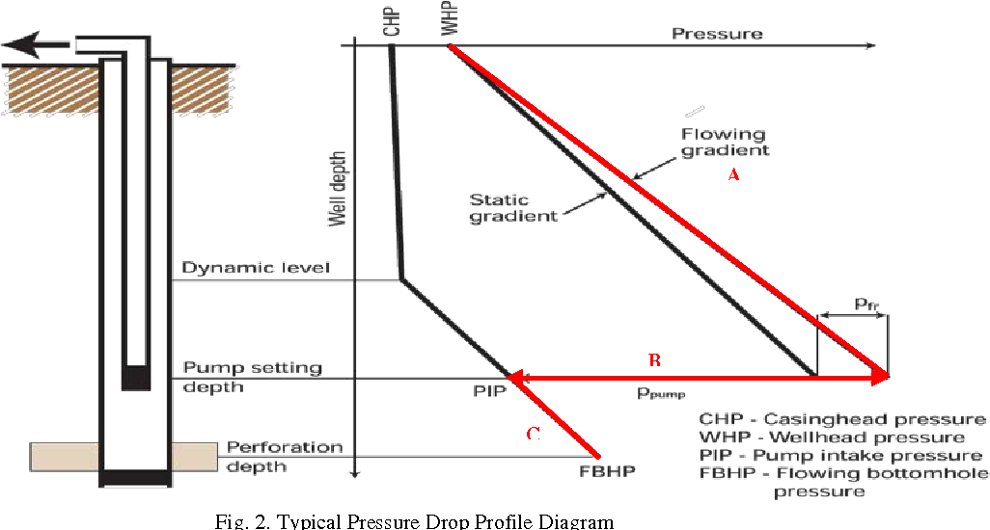
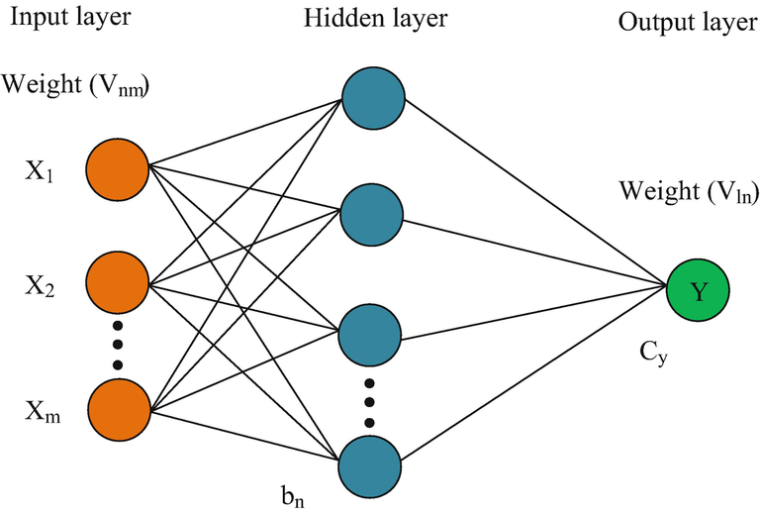
AIMS AND OBJECTIVE
To predict the flowing bottom hole pressure of an oil producer well from well data using four different machine learning modes, and see how it compares to the actual bottom hole pressure.

Slide 6
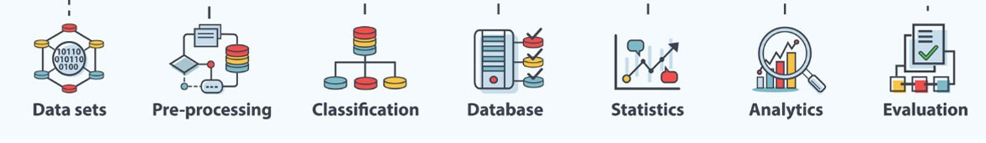
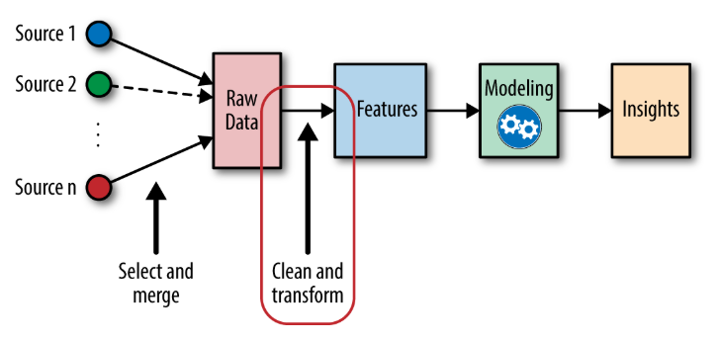


METHODOLOGY
1) DATA ACQUISITION AND PREPROCESSING
2) FEATURE ENGINEERING
3) MODELLING
4) TESTING

Slide 7
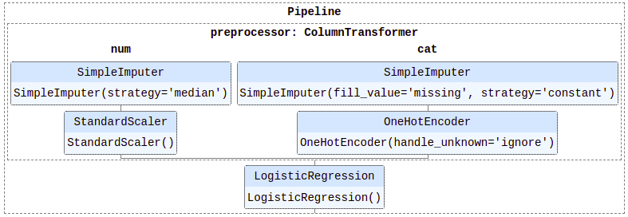
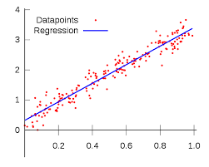

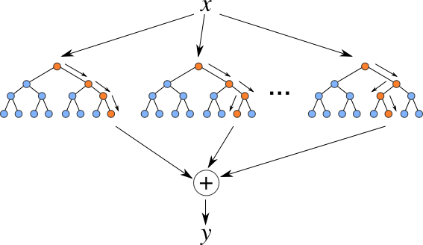
MODELS
SK LEARN PIPELINE (REGRESSOR AND STANDARD SCALER)
LINEAR REGRESSOR
DECISION TREES REGRESSOR
RANDOM FORESTS REGRESSOR

Slide 8


MODELS
ARTIFICIAL NEURAL NETWORKS (ANN)
Hidden Layer: Activation = “RELU” optimizer = “Adam”, loss = “mse”, metrics= “mae”
Input: ['BH_TEMPERATURE', 'DP_TUBING', 'CHOKE_SIZE_P','WH_PRESSURE', 'WH_TEMPERATURE', 'OIL_VOL', 'GOR', 'WC‘]
BHP

Slide 9
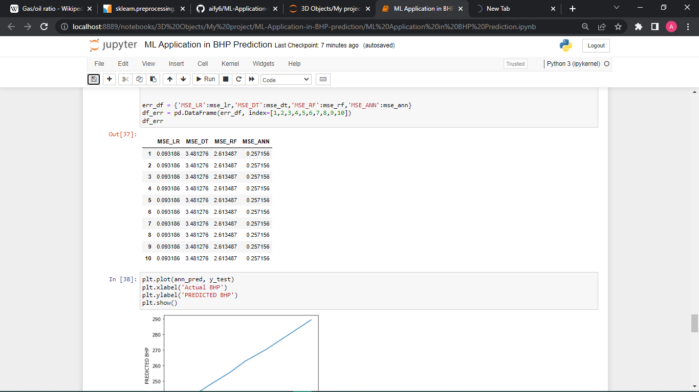
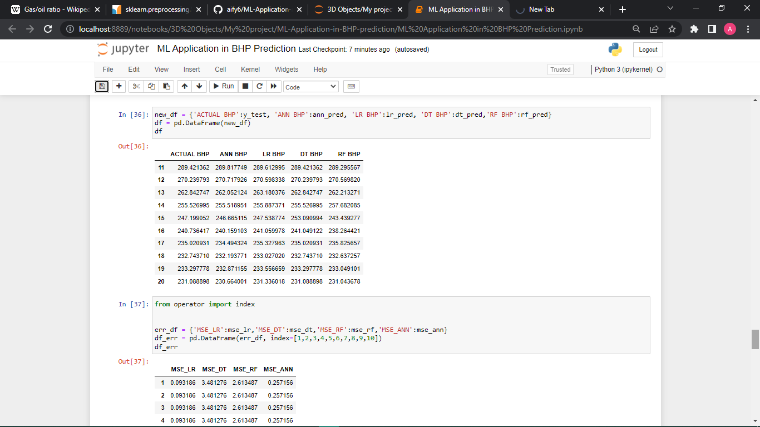
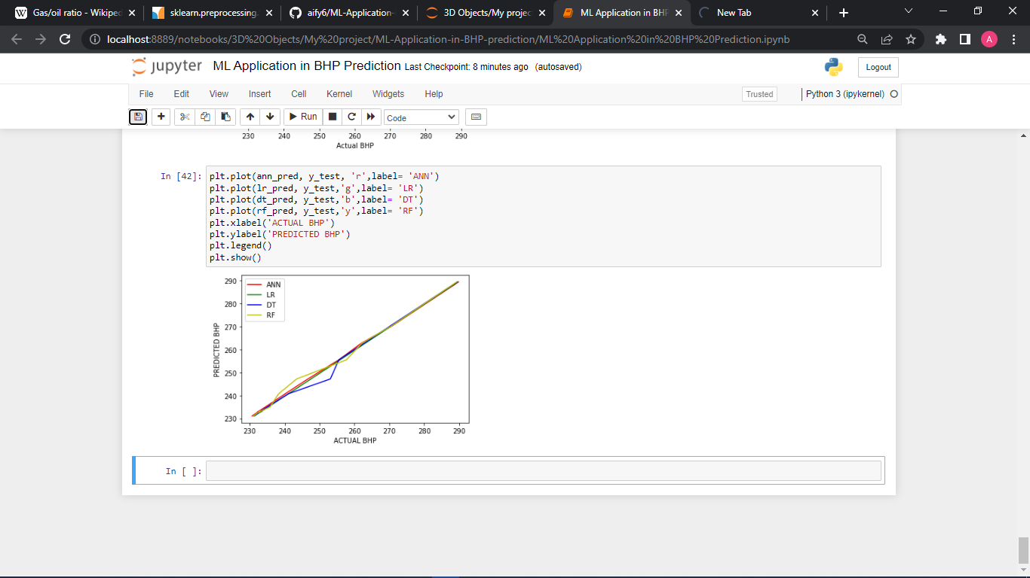
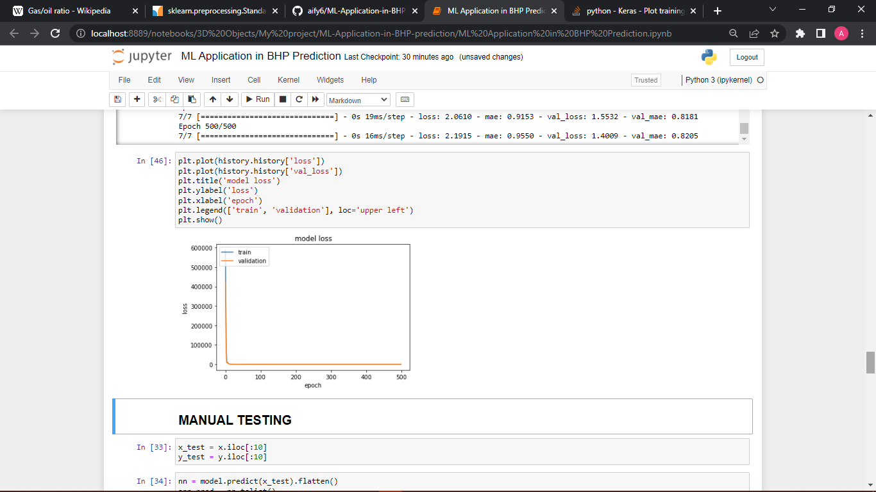
RESULTS AND DISCUSSIONS
Four machine learning algorithms: Decision Trees, Random Forest Regressor, Linear Regressor, and Artificial Neural Network apply to the selected input variables shown earlier.
After the data preprocessing steps, the selected machine learning models were built on the training dataset. The evaluation of each algorithm was essential to ensure the quality of the employed model.
The models are fit to the training dataset and then used to predict the flowing bottom hole pressure for the training and testing dataset.
The table below compares how the machine learning models performed in relation to the actual bottom hole pressure from the well data and the mean squared error (MSE)
Mean Squared error

Slide 10




THANK YOU!!
BHP

